Slide 1





WELCOME TO!
HOPE

Slide 2
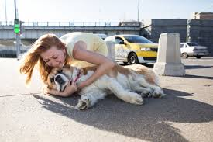
PROBLEM STATEMENT
Vehicle-animal collisions pose serious risks to both human and animal lives, as well as causing significant vehicle damage. Current systems lack efficient real-time detection of animals near roads, leading to accidents. A solution is needed to detect animals and humans near vehicles, assess risk, and provide timely warnings to prevent collisions, ensuring safer roads and reducing fatalities and damage.

Slide 3

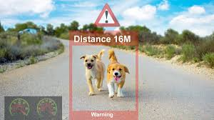
SOLUTION
•Detects animals and humans within a set range, alerting the driver to slow or stop.
•In case of a collision, when vibration sensor’s intensity goes at high, GPS will trigger at that time and GSM will send an SMS of location, date, and time.
•GSM module sends an SMS with collision details to relevant parties and also an ML Model will differentiate between animals and humans.
Working Vedio:
https://drive.google.com/file/d/142YYFofiSiP4kWFDBwh3HjBIMxDLxX0b/view?usp=drivesdk
Website offers:
Information on animal importance and driving guides.
History of animal-vehicle collisions.
Instructional videos on helping injured animals.
Website Link: https://0c87b535-59c1-46e4-8375-1c9db4a5deb7-00-3pvbhz14ldhv6.pike.replit.dev/
•Similar to ADAS animal detection system with added post-collision support.

Slide 4
SYSTEM ARCHITECTURE
Key Hardware Components:
Data Flow:
Ultrasonic sensor: Detect animals/humans or any object within the respective range.
Vibration/ Shock Sensor: Detects collisions.
GSM & GPS Modules: Sends SMS with location, date, and time after a collision.
Microcontroller (ESP32/Arduino): Central control unit.
Buzzer: Alerts driver when an object is detected.
ML Model: It will detect whether there is a animal or human.
Power Supply: Ensures system functionality.
Detection: Sensors continuously monitor surroundings.
Driver Alert: Buzzer activates when an object is in danger range.
Post-Collision Action: Upon impact, SMS with collision details is sent.
System Communication:
Sensors -> Microcontroller -> GSM for alerts and notifications.
Website Integration:
Log history of collisions and provide educational content for drivers.

Slide 5
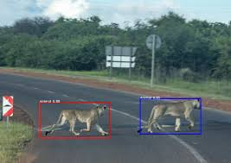
WORKING MECHANISM
The Human Safety System helps prevent road accidents by using sensors (ultrasonic or infrared) to detect people near the road. A small computer (ESP32) processes the data to check if a person is present. When someone is detected, a buzzer warns the driver. An AI model then confirms if it is really a human. If there is a risk of an accident, the system sends an SMS alert to the driver’s emergency contacts and local authorities using a GSM module. It also adjusts to different environments to reduce false alarms. Thorough testing ensures the system works accurately, making roads safer for everyone.

Slide 6

WEBSITE FEATURES
Importance of Animals: Information on the role and significance of wildlife.
Driving Guides: Tips and recommendations for safe driving around animals.
Chatbot Assistance: Provides help and guidance for drivers who have accidentally hit animals and are unsure how to assist them.
Collision History: Records and displays data on past collisions involving animals or humans.
Real-Time Map Integration (Future): A map linked with Google Maps for tracking and locating incidents.
SOS Call Feature(Future): Alerts the driver’s family in case of a collision, ensuring they are informed immediately.

Slide 7
FUTURE SCOPE
Chat-bot Assistance in website: Provides help and guidance for drivers who have accidentally hit animals and are unsure how to assist them.
ML Model on animals and humans.

Slide 8

BUSINESS REVENUE
Pricing: $30 per unit.
OLLA:
Units Sold: 5,000 annually.
Annual Revenue: 5,000 units × Rs.1300/unit = Rs.6,50,000
Uber:
Units Sold: 20,000 annually.
Annual Revenue: 20,000 units × Rs.1300/unit = Rs.26,000,00.
Total Annual Revenue: Rs.6,50,000(OLLA) + Rs.26,000,00 (Uber) = Rs.26,650,000.

Slide 9
THANK YOU

